Slide 1
Project Intro
Lec 12

Slide 2
Last Time
Discussed how AI interventions are implemented in the clinic
Thought through different high-level implementations of ideas
Problem type
Training regime
Input/output data
FDA device approval

Slide 3
Big Idea
Come up with an AI intervention of your own creation
Based on a clinical question, ideally from your specialty
Should be novel and not something already done

Slide 4
Part 1: Problem Formulation
Think about various workflows in your field.
How are diagnoses made?
Given a diagnosis, how do we decide which treatment is appropriate?
How are patient encounters/histories/diagnoses/treatments documented?
Are there logistic challenges that could be addressed?
Develop a clinical question that addresses a challenge in your field
Ensure this question is novel
Search arxiv and pubmed to ensure this idea hasn’t been tried before
Note: if implementation is novel enough you can repeat idea

Slide 5
Part 1: Problem Formulation
Deliverables:
What is the clinical question?
One paragraph on the relevance of this question to your field
Few sentences on related literature and what has thus far been tried, either in related conditions or with similar approaches and why your approach is novel
Note: Specific is better, should include input data and outputs
Examples:
Can we predict sepsis at any point in emergency room patients based on clinical data collected in the first 24 hours?
Based on vital signs at an outpatient visit, can we predict a patient’s hemoglobin level?
Using patient interview transcripts, can we predict their MOCA score?

Slide 6
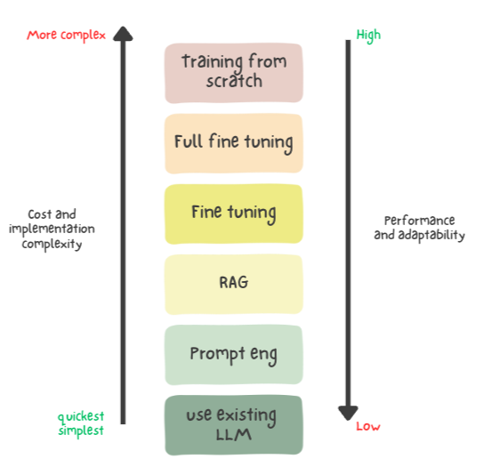
Part 2: Implementation
What AI approach will be used to address this question?
Task:
Classification (multiclass) (multi single class)
Regression
Does your task have a special simplified name? i.e. image segmentation = pixel-based classification
Generative?
Don’t confuse LLM training with prompting
Notes:
image segmentation is classification of individual voxels based on small image patches
No using existing LLM on a task or prompt engineering

Slide 7
Part 2: Implementation
Deliverable: What is the technical problem statement?
Deep learning based classification of patients into sepsis and sepsis free groups based on data from first 24 h of admission
Prediction of patient hemoglobin levels using deep learning regression based on vital signs at outpatient visit
Segmentation of soft tissue sarcoma using multimodal CT-MRI-PET data
Prediction of patient MOCA scores using deep learning based regression on language embedding encoded interview transcripts
Deliverable: Few sentences on why this approach to implementation makes sense.
Notes:
image segmentation is classification of individual voxels based on small image patches

Slide 8
Part 3: Data Sourcing
What data will you need and why? Ex. If you are doing prediction of hemoglobin, do you need their IgM level?
How will you acquire the data used in this project?
Are there any public datasets that can be used? If not, why?
Will the data need to be cleaned, standardized or preprocessed at all? Will we remove outliers? Should some part of the input data be discarded? What biases might your approach of data gathering lead to?
Deliverable: Answer the above questions in a paragraph

Slide 9
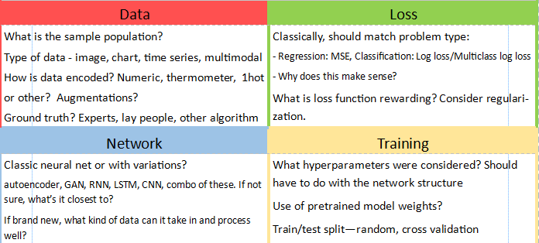
Part 4: Additional Technical Dive
Deliverable: A paragraph on one of these technical areas and what the considerations will be in your intervention

Slide 10
Part 5: Deployment and clinical relevance
Deliverable: Few sentences on output metrics that will be tracked to determine and monitor the success of the algorithm
F1, AUROC, Sensitivity, Specificity, PPV, ballpark numbers that would be acceptable
Deliverable: Paragraph on potential pitfalls to rollout in the clinic. What would biased results look like in the final model? Could the results slow down workflows in an unexpected way? How will periodic surveillance for data drift be implemented?

Slide 11
Use of AI
Let AI be your assistant, not your replacement
Use AI as you see fit, but be ready to explain your choices verbally
Any work AI does that you turn in you place your seal of approval on, including errors
Last day of class will call on some people randomly to discuss various decisions they’ve made

Slide 12
Grading
10/10 possible on each section, maximum 50/50
Will be graded on correctness, clinical relevance and mastery of technical knowledge
Thoughtful responses that show clear effort will definitely pass
70% is passing, 50% of overall course grade
Will be averaged with attendance percentage to determine final grade
Bonus up to 10% if you give a 10-15 min powerpoint presentation to the class on last day
Reserve the right to award lower scores on a given section if it is blatantly AI generated with zero edits + cannot explain when asked

Slide 13
Final Thoughts
You get out what you put in
Work hard on this and it could become a real research question you attempt to solve!
Matthew and myself are available after class for up to 1 hour to answer any questions that come up

